Slide 1
Welcome to Maple!

Slide 2
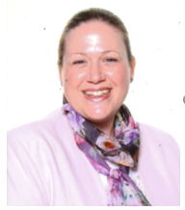
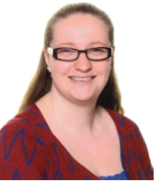
Welcome to Maple!
Claire Barwell – Head Teacher
Helen Funnell–Deputy Head
Jess Dowd – EYFS Leader
We wish we could have welcomed you into our school to start to get to know all of our new families and to see our current families.
Please know we cannot wait for your children to join our Maple family and begin their learning journey with us.
Your children remain our priority and we will work in collaboration with you to ensure they have a successful start in our Reception.

Slide 3
Aims of the presentation
To welcome you to the Maple community (virtually!)
To introduce the EYFS curriculum and the team
To explain the skills children need when they start school
To put your mind at ease about the transition into school
To signpost you to additional support for transition – e.g. staff reading stories online

Slide 4
Reception Team

Slide 5
Maple Infants’ School Vision and Mission

Slide 6
Transition to Reception
Transition looks a little different! – Photos of the staff and transition bags delivered to home, stay and play – rescheduled
Reception parents – visit to teacher will be replaced with a Google Meet and there will be an additional welcome meeting in September to share class information.
Phased transition into Reception
Parents as partners – Sharing information
Preparing your child for school – Reading stories and talking about school
Encourage independence –Toileting and dressing

Slide 7
The Early Years Foundation Stage
There are 3 Characteristics of Effective Learning:
Playing and exploring
Active Learning
Creating and thinking critically
Finding out and exploring.
Playing with what they know.
Being willing to ‘have a go’
Being involved and concentrating
Keeping trying
Enjoying achieving what they set out to do
Having their own ideas.
Making links.
Choosing ways to do things

Slide 8
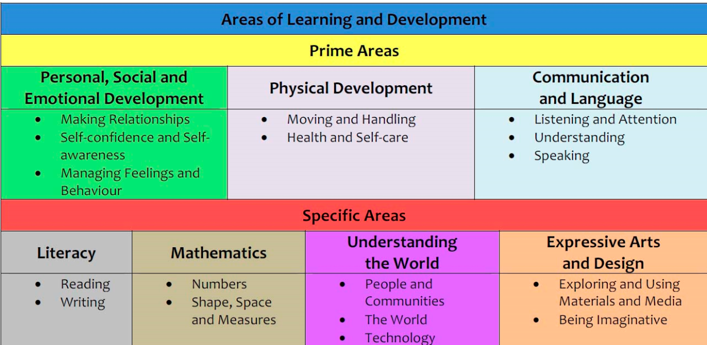
The Early Years Foundation Stage
There are 3 Prime Areas and 4 Specific Areas of Learning:
The prime areas of learning are fundamental in the EYFS and the specific areas of learning provide important contexts for learning. These areas of learning are taught together to support a rounded approach to your child’s development.

Slide 9
Continuous Provision
The indoor and outdoor classroom
Adult –led
Adult-framed
Child-initiated

Slide 10
Assessment in the EYFS
Learning Journeys
Photographs, assessment labels, pupil voice and termly reflections
Independent learning – applying new learning
Parental support – Wow cards and Technology cards
Parent workshop – phonics

Slide 11
Attendance and Punctuality
Attendance – Impact on progress and learning
Starting the school day and collection arrangements
Sickness – 48 hour rule
Leave of absence

Slide 12
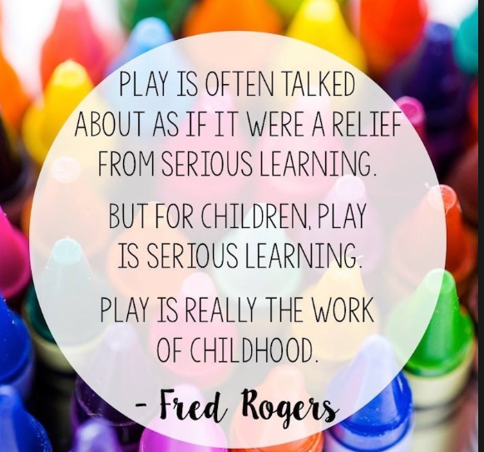
School Uniform
Uniform - Shoes
PE kit
Label all items – even socks!
No Jewellery
Water bottles
Rain coat – Outdoor learning

Slide 13
SEND and Inclusion
Sharing any queries or concerns with SENCO (Miss Funnell)
Working in partnership to ensure children can access provision fully
Working with external agencies

Slide 14
The Friends of Maple Infants
Registered Charity #1147762
www.friendsofmaple.org
contact@friendsofmaple.org

Slide 15
We can’t wait to meet you!
We have made contact with all nursery settings where possible to have a virtual handover
Phased transition will ensure children form excellent relationships with adults and develop confidence within their classroom
Staff are highly skilled in working with new pupils and will remain committed to ensuring they settle well

