Slide 1
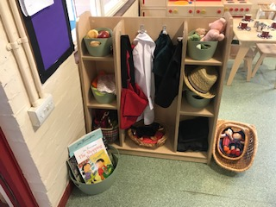
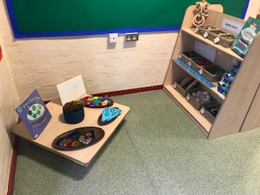
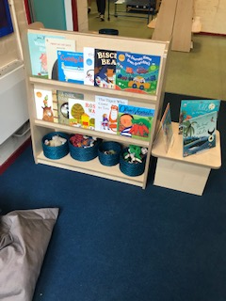
Nursery
Welcome to Maple!

Slide 2
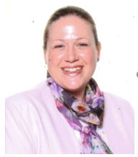
Welcome to Maple!
Claire Barwell – Head Teacher
Helen Funnell–Deputy Head
Jess Dowd – EYFS Leader
We wish we could have welcomed you into our school to start to get to know all of our new families and to see our current families.
Please know we cannot wait for your children to join our Maple family and begin their learning journey with us.
Your children remain our priority and we will work in collaboration with you to ensure they have a successful start in our Nursery.

Slide 3
Aims of the presentation
To welcome you to the Maple community (virtually!)
To introduce the EYFS team
To introduce the Early Years Foundation Stage (EYFS)
To explain the skills children need when they start Nursery
To put your mind at ease about the transition into Nursery
To reassure you that we will support children as they complete the slightly different transition into Maple.
To signpost you to additional support for transition – e.g. staff reading stories online and welcome video.

Slide 4
Nursery Team

Slide 5
Maple Infants’ School Vision and Mission

Slide 6
Transition to Nursery
Transition bags – Photos of the staff
Transition visits September– Stay and play
Parents as partners – Sharing information
Preparing your child for school – Reading stories and talking about Nursery
How we will support you and your child- Staggered intake in September, Google Meet
Encourage independence –Toileting and dressing

Slide 7
The Early Years Foundation Stage
There are 3 Characteristics of Effective Learning:
Playing and exploring
Active Learning
Creating and thinking critically
Finding out and exploring.
Playing with what they know.
Being willing to ‘have a go’
Being involved and concentrating
Keeping trying
Enjoying achieving what they set out to do
Having their own ideas.
Making links.
Choosing ways to do things

Slide 8
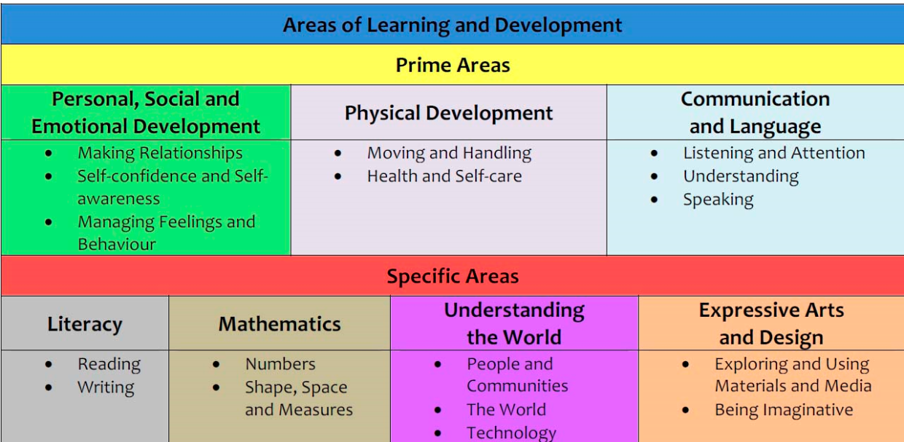
The Early Years Foundation Stage
There are 3 Prime Areas and 4 Specific Areas of Learning:
The prime areas of learning are fundamental in the EYFS and the specific areas of learning provide important contexts for learning. These areas of learning are taught together to support a rounded approach to your child’s development.
The prime areas of learning are the primary focus throughout the Nursery year.

Slide 9
Continuous Provision
The indoor and outdoor classroom
Adult –led
Adult-framed
Child-initiated

Slide 10
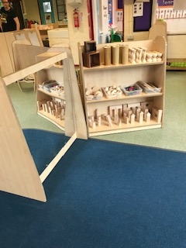
Assessment in the EYFS
Learning Journeys
Photographs, assessment labels, pupil voice and termly reflections
Independent learning – applying new learning
Parental support – Wow cards
Sharing books – To build communication and language skills.
TALK TALK TALK!

Slide 11
School Uniform
Uniform – Maple top (optional)
Suitable footwear – velcro and closed toes
Sun hats and winter hats
Spare clothes
No jewellery
Water bottle
Rain coat and hat – outdoor learning

Slide 12
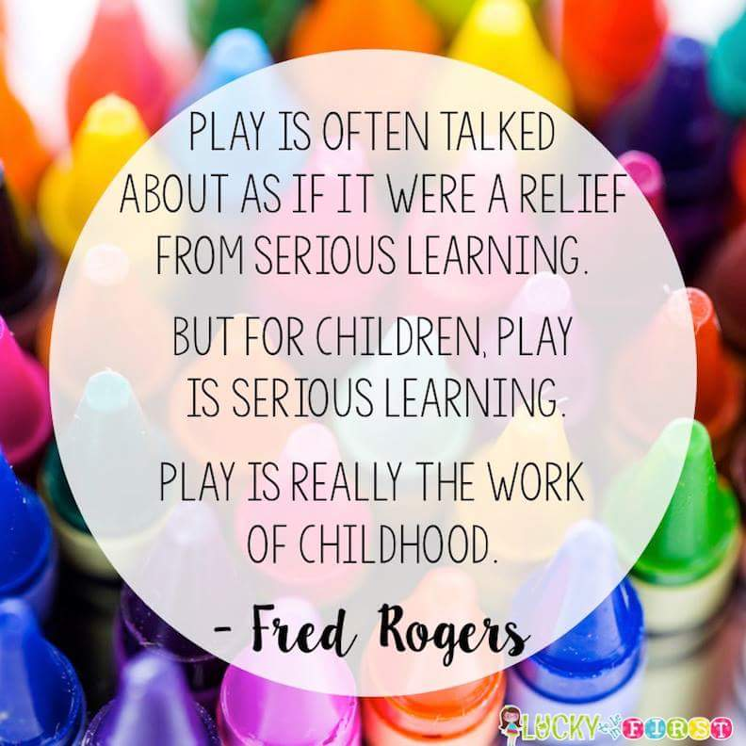
Daily Routines
Nursery AM session usually starts at 8:45 and finishes at 11:45. In September to support staggered entry into Maple, Nursery AM will start at 8:30 and finish at 11:30
Nursery PM starts at 12:30 and finishes at 15:30
Session structure
Constant access to the outdoor area
Collecting your child –pickup arrangements

Slide 13
Attendance and Punctuality
Starting the day – safeguarding
Attendance – Impact on progress and learning
Leave of absence requests
Sickness – 48 hour rule

Slide 14
SEND and Inclusion
Sharing any queries or concerns with SENCO
(Miss Funnell)
Working in partnership to ensure children can access provision fully
Working with external agencies
Offering additional support in class

Slide 15
The Friends of Maple Infants
Registered Charity #1147762
www.friendsofmaple.org
contact@friendsofmaple.org

Slide 16
We can’t wait to meet you!
Phased transition will ensure children form excellent relationships with adults and develop confidence within their classroom
Staff are highly skilled in working with new pupils and will remain committed to ensuring they settle well

