Slide 1
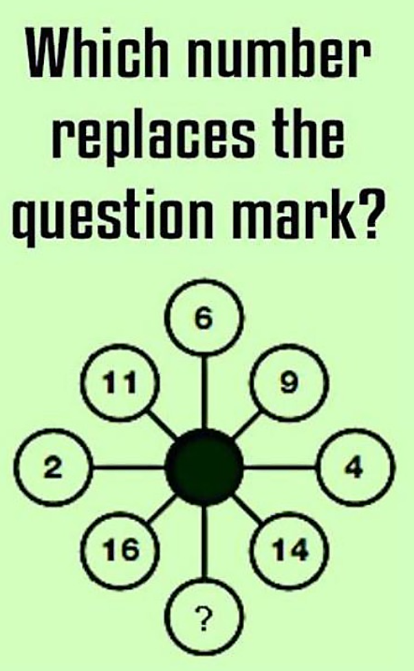
Challenge
September 2017
Maple Infants’ School
David Wells

Slide 2
Why was Mathematics Mastery developed?
Mathematics Mastery
Success in mathematics for every child
Close the attainment gap
Notes:
Why this approach was developed – WHY DID WE CHOOSE THIS APPROACH FOR MAPLE?
New Curriculum
Pupil progress: Language and problem solving
Staff CPD

Slide 4
Two beliefs about INTELLECTUAL ABILITY
Mathematics Mastery
Innate ability –
FIXED MINDSET
Effort-based ability –
GROWTH MINDSET
Notes:
Brings us to our mindset: all children can achieve, regardless of background.
Parents must be on board with effort-based ability and not bring in their own experiences of maths learning
Encourage parents to be enthusiastic about maths at home, constantly positive.

Slide 5
Belief in Innate Ability
BELIEFS
Inborn
intelligence
is the main
determinant
of success
ASSUMPTIONS
Ability is fixed
“You either
have it or you
don’t”
OUTCOMES
Poor Results
Defeatism

Slide 6
Belief in Effort-Based Ability
BELIEFS
Consistent effort
and effective
strategies are
the main
determinants of
success.
OUTCOME
Engagement
Confidence
Results
ASSUMPTIONS
Effort =
Development
Notes:
Mathematics mastery assumes this belief. All born with one brain. Growth mindset Carol Dweck
Individuals can be placed on a continuum according to their implicit views of where ability comes from.
Fixed-mindset individuals dread failure because it is a negative statement on their basic abilities, while growth mindset individuals don't mind failure as much because they realize their performance can be improved. These two mindsets play an important role in all aspects of a person's life. Dweck argues that the growth mindset will allow a person to live a less stressful and more successful life.
This is important because (1) individuals with a "growth" theory are more likely to continue working hard despite setbacks and (2) individuals' theories of intelligence can be affected by subtle environmental cues. For example, children given praise such as "good job, you're very smart" are much more likely to develop a fixed mindset, whereas if given compliments like "good job, you worked very hard" they are likely to develop a growth mindset. In other words, it is possible to encourage students, for example, to persist despite failure by encouraging them to think about learning in a certain way.

Slide 7
YET

Slide 8
Mathematics Mastery
National Curriculum
What are the aims?
To become fluent in the fundamentals of mathematics, including through varied and frequent practice with increasingly complex problems over time, so that pupils develop conceptual understanding and the ability to recall and apply knowledge rapidly and accurately
To reason mathematically by following a line of enquiry, conjecturing relationships and generalisations, and developing an argument, justification or proof using mathematical language
Pupils can solve problems by applying their mathematics to a variety of routine and non-routine problems with increasing sophistication, including breaking down problems into a series of simpler steps and persevering in seeking solutions.
Notes:
Include here why your school have taken on the approach

Slide 9
Most importantly!
The NC states:
The expectation is that the majority of pupils will move through the programmes of study at broadly the same pace.

Slide 10
Mathematics Mastery
Curricular principles
Fewer topics in greater depth
Opportunities are provided throughout Mathematics Mastery for pupils to use reasoning skills to make connections between prior knowledge and newly presented material. These connections will help foster a deeper understanding of the maths concepts.
Mastery for all pupils
Differentiation through depth, cumulative learning, AfL
Number sense and place value come first
Traditional algorithms meaningfully taught
Problem solving is central
Comprehension, calculation and problem solving developed simultaneously.
Notes:
No racing ahead
Stress points one and two. Pupils are not going to be ‘climbing’ the curriculum, but going deeper into it. In year 1 it is imperative that pupils have full understanding of number sense, number bonds, place value. All number work in maths builds on what is taught here. Ensure parents that understanding maths and thinking like mathematicians is NOT just knowing maths.

Slide 11
Lesson structure
Do Now
New learning
Develop learning
Independent task
Plenary
Talk task
Ofsted OUTSTANDING: Planning is astute Time is used very well Every opportunity is used to successfully develop crucial skills (inc. literacy and numeracy) Lessons proceed without interruption Appropriate independent learning tasks are set Pupils are resilient, confident and independent Well judged and often imaginative teaching strategies are used
Notes:
This is the suggested lesson structure that provided lessons come in.
We are not obliged to stick to this structure but Mathematics Mastery do expect to see talk tasks and some independent work in each lesson. Each component of the lesson sequence will be explored at training.

Slide 12
Vocabulary
Referred to as
STAR WORDS
All responses should be in FULL ‘Maths Sentences’
E.g. “What is 13 and 8 altogether?”
“The total of 13 and 8 is 21.”

Slide 13
ACTIONS
more less/fewer
altogether
…is equal to…
order
part-part-whole

Slide 15
Models and Images
Lessons are rooted in the C P A approach
1.Concrete
2.Pictorial
3.Abstract
Notes:
CONCRETE – Beginning with physical apparatus – SWEETS/APPLES/BEARS/ALIENS - After that explaining that cubes could REPRESENT the BEARS etc.
PICTORIAL – Using drawings – SWEETS
ABSTRACT – The equation or mental imagery

Slide 16
Notes:
TENS FRAME
WHOLE-PART-PART MODEL
DIENES – BASE 10 - MULTIBASE

Slide 17
Notes:
BIG PICTURES – Discuss the display outside the hall.
Change each unit.

Slide 18
Next Steps for Depth
‘What’s the question?’
If this is the answer, what could the question have been?
‘What’s wrong with this?’
Can you explain what is wrong with the example below and correct the error?
‘Draw it’
Draw a picture to explain or demonstrate what you have worked out
‘Reason it’
Explain to your partner how you know. Remember to use the star words!
‘Prove it!’
Convince me that you are right.
‘Empty box question’
What goes in the empty box(es)?
‘Find a pattern’
Can you see a pattern (in the numbers)?
Can you see a pattern in the answers?
‘Before and after’
What came before? What comes next?
Explain how you know
‘Tell a story’
Make up a real-life story using your equation/numbers or shapes.
‘Odd one out’
Find an odd one out and explain why it doesn’t fit.
Could another one be the odd one out? Why?
Notes:
NOW – Differentiate the given lesson!

Slide 19
Now it’s your turn…
National Curriculum Programme of Study Statement
Pupils should be taught to:
solve one-step problems involving multiplication and division, by calculating the answer using concrete objects, pictorial representations and arrays with the support of the teacher.

Slide 21
STAR WORDS
Can you use some of these in your discussion?
repeated addition
array
row
column
double
halve
share,
share equally
equal groups of
divide
count in twos, threes, fives
count in tens
(forwards from/
backwards from)
how many times?
lots of, groups of
multiple of
times
multiply

Slide 22
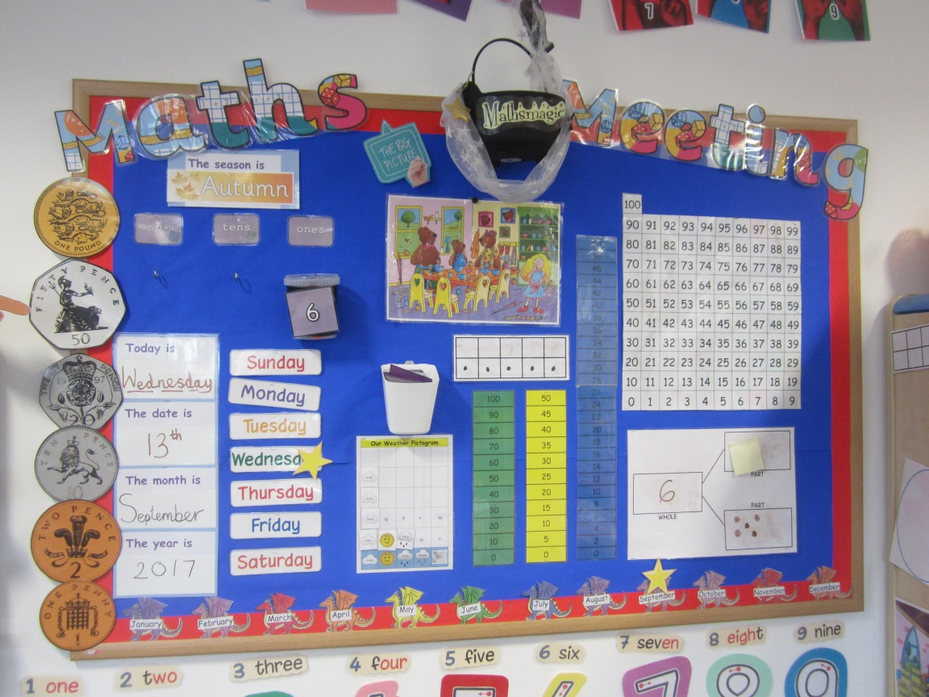
Repetition
Maths
Meetings
Maths Meetings are regular, 15 minutes ‘mini lessons’, which are used to consolidate key areas of mathematics in our classes.
Songs
Chants
Games
Maths Meetings provide an opportunity to teach and revise 'general knowledge maths' which may not explicitly be covered during the maths lesson, and also allows the integration of maths into the surrounding environment. This means that pupils are practicing concepts and skills on a regular basis, meaning they are continually building on their mastery of these concepts.

Slide 24
PUPIL VOICE – Mathematics Mastery “Using objects helps me to understand maths more.” “I like maths, sometimes it’s hard, but it helps me to learn it!” “It’s fun and not boring and I like talking with my talk partner.” “Maths Meetings are happy and you get to sing and learn lots.” “I like to learn maths because we learn adding and taking away – that’s my favourite!” “Maths makes me feel good about myself.”

Slide 25
Challenging pupils working at
Greater Depth

Slide 26
‘Trial and improvement’
style problems

Slide 27
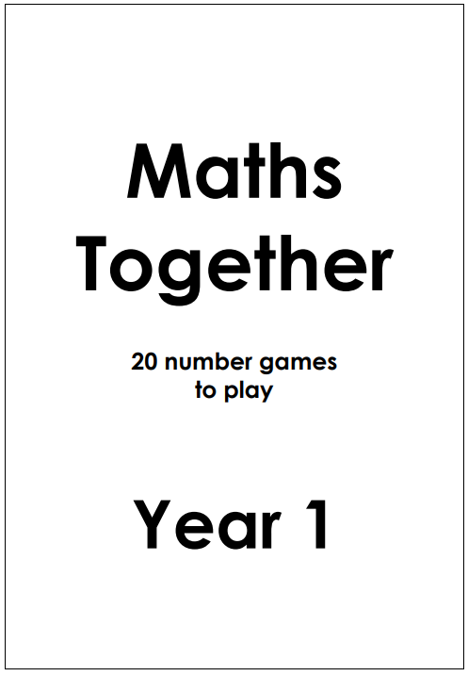
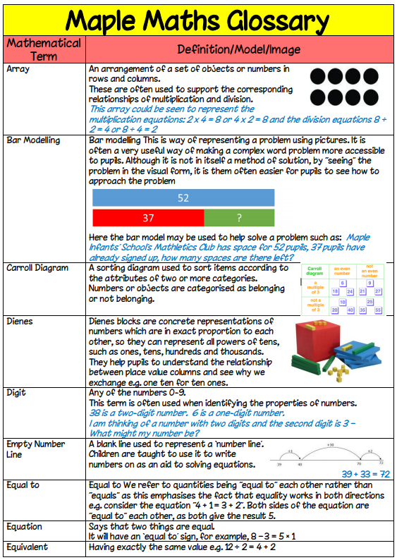
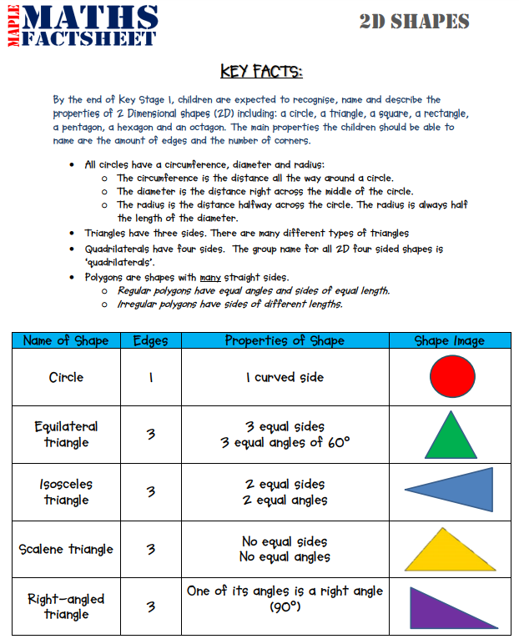
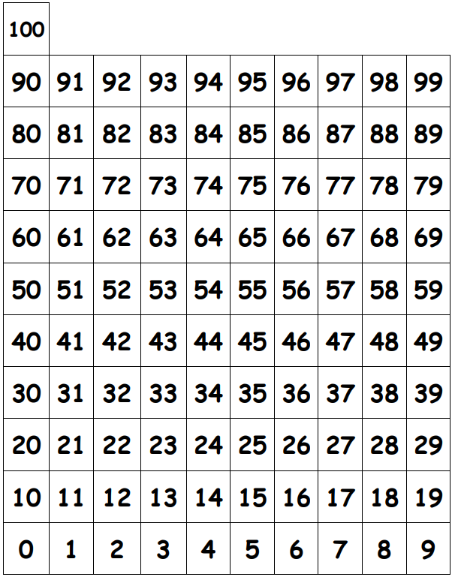
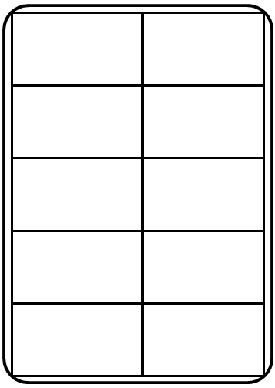
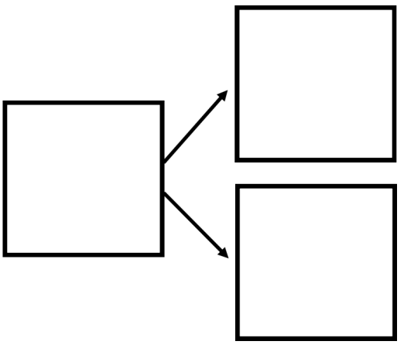
MATHEMATICS on Maple Infants’ School Website
www.mapleinfants.co.uk/mathematics

